Slide 1
SMALL PROJECT 2 FUNCTIONAL TEST
Yulia Handayani

Slide 2
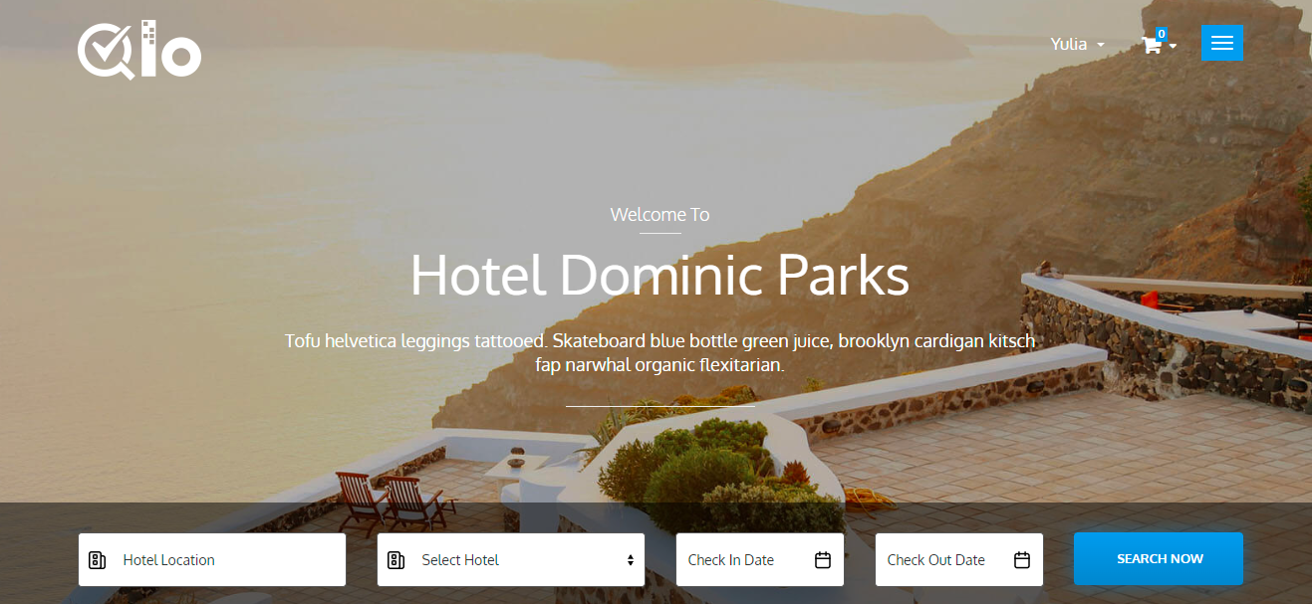
What to Test?
A Web Application for Booking Hotel

Slide 3
Tested Features
No | Feature Name
1 | Register
2 | Sign in and Sign Out
3 | My Account Dashboard
4 | Booking Cart
5 | Navigation Menu
6 | Search Hotel
7 | Footer Bar

Slide 4
Functional Requirement
User can access website properly
User can successfully register
User can successfully sign in
User can successfully book a room
User can successfully make a payment

Slide 5
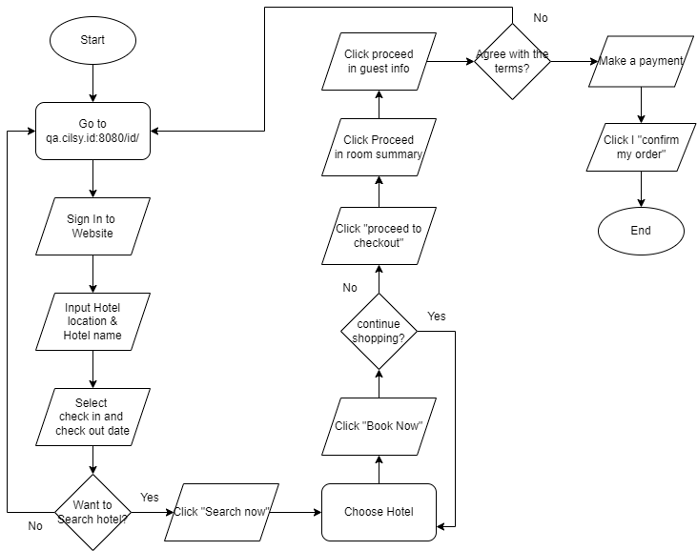
Book A Room FlowChart

Slide 6
Total Test Case
Name | Total Scenario | Total Test Case
Manual Test Case | 32 | 116
Automation Selenium | 8 | 18
BDD Cucumber | 4 | 9

Slide 7
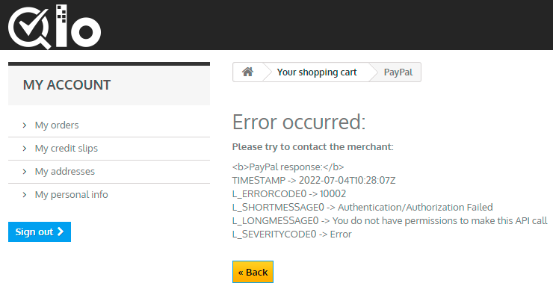
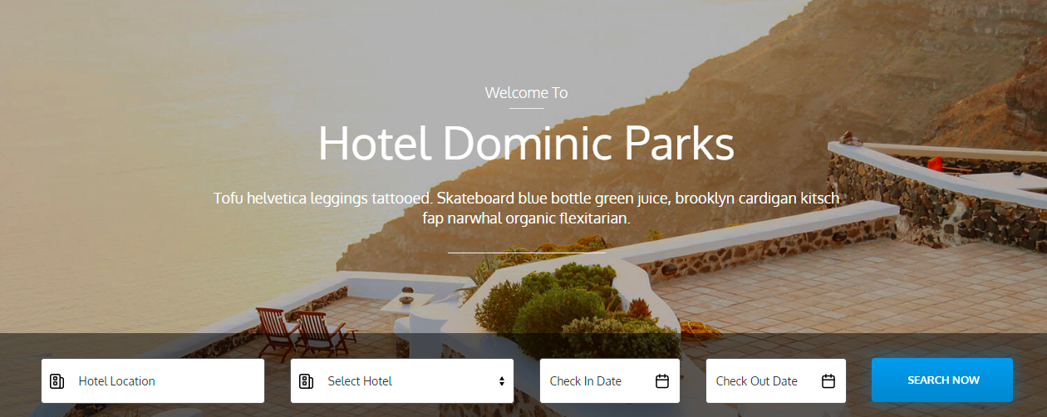
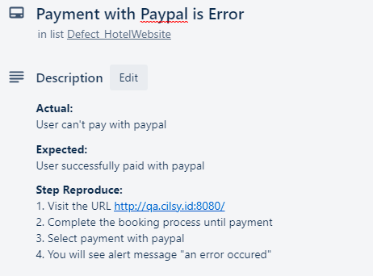
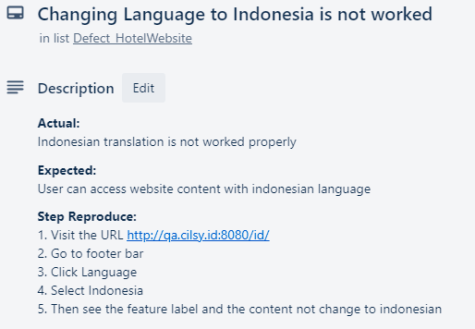
Reporting Defect

Slide 8
Selenium Report
Click here, go to Selenium Report

Slide 9
BDD Report
Click here, go to Selenium Report
And
Click here

Slide 10
Advantages and Disadvantages Selenium & BDD
NO | Advantages | Disadvantages
1 | Open - Source | Need third party to print a report
2 | Support many programming language | Take times for loading response
3 | Can run in any IDE | Can’t write the same test step for BDD
4 | Can run many scenarios in one go | Need effort about installation
5 | BDD is easy to understand by no technical person
6 | Have many communities to ask if get stuck

Slide 11
Technical Testing Obstacles
Cucumber Reporting Setting
Cucumber Reporting Plugin often get Error
Automate testing is sometimes passed & failed for one scenario
Little bit knowledge of keywords/methods

Slide 12
Thank You

